Slide 1



Exploratory Data Analysis
Sales Forecast
DS4A team 77

Slide 2

THE PROBLEM
DS4A team 77
Teaté: Connecting suppliers of goods and services with micro-merchants.
Deals with multiple convenience stores around the country.
The demand for each product changes over time and across locations in the city.
No knowledge about the amount demanded for each product in each location.
Importance
Retail sector - impact on social and economic growth in Colombia.
Retail sector growth rate has been going down during this year.
Opportunity for Teaté to consolidate as a strategic ally for micro-merchants in the Colombian market.

Slide 3

UNDERSTANDING THE DATA
DS4A team 77
Data set:
650 K records for purchase orders by 9,335 shopkeepers
Data from January 2019 to August 2020).
53 columns: 30 String - 13 integer - 11 float.
Some relevant variables
FIELD | TYPE | DESCRIPTION
Order Number | INTEGER | Order number. It is a consecutive assigned by the SAP system to each order.
Order Date | STRING | Date on which the order is registered in SAP.
Quantity Delivery | FLOAT | Number of units of the product that are included in the order.
Minimarket Name | STRING | It is the name of the store or commercial establishment that places the order.
Total Order Value | FLOAT | It is the unit value multiplied by the quantity ordered
Notes:
What are the most relevant variables?
The most relevant variables for the analysis are: Order, Store, Manufacturer, Order date, Invoice date, Store creation date, Order quantity, Order unit value, Teaté Discount, Order entry value, Total value of the order.

Slide 4
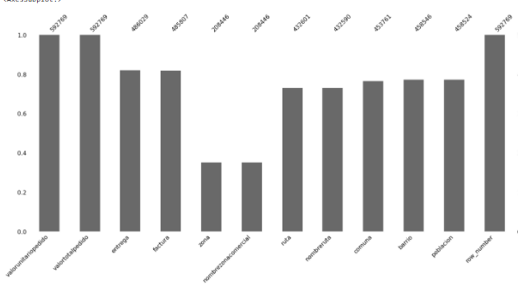
MISSING VALUES
DS4A team 77
Our main source of missing value is geographic categorical values. Imputing the information with its own historical values or using geographic information (APIs, Geopandas or others) it is possible to fill these values appropriately.
We would geocode (‘lat,Lng’ for stores locations and map them )

Slide 5
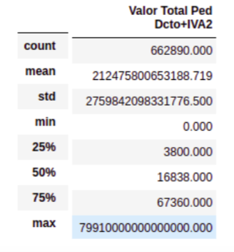
IDENTIFYING OUTLIERS…
DS4A team 77
Outliers or typing-errors?
All the columns with prices and monetary value have atypical values
max total values
Finding real values
Extreme values
Dropping the values outside inter-quartile range

Slide 6
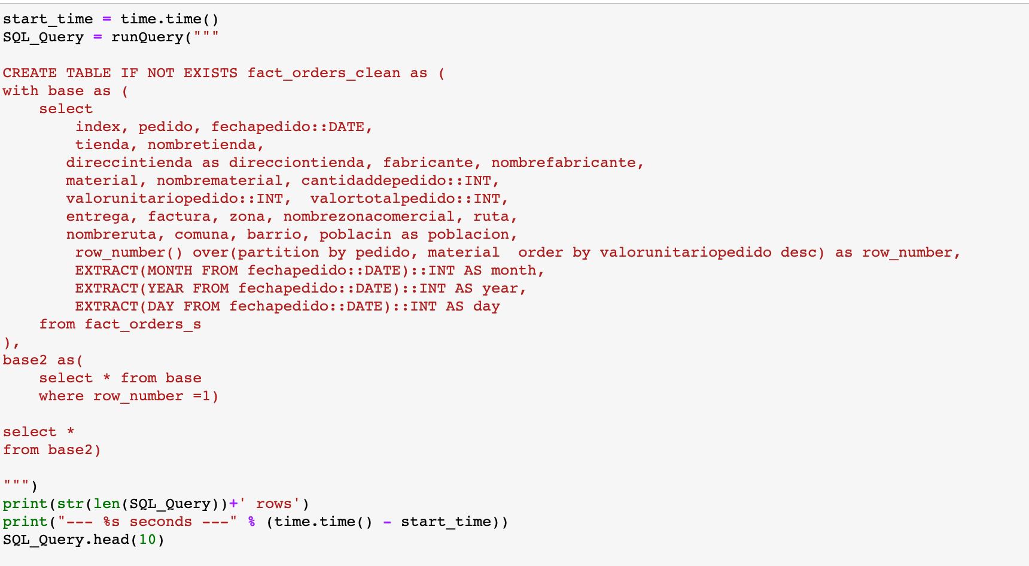
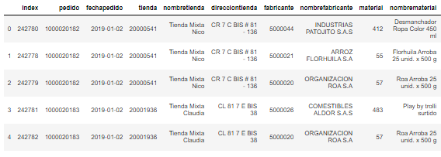
CLEANING DATA - SQL
DS4A team 77
Many duplicated rows: approx 50 K rows removed; representing after request modifications
We kept 27 Columns
We removed variables with no relevant information and those consisting mostly on null values

Slide 7
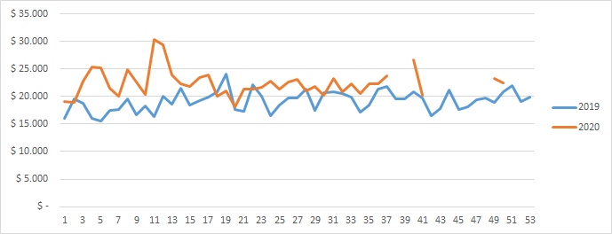
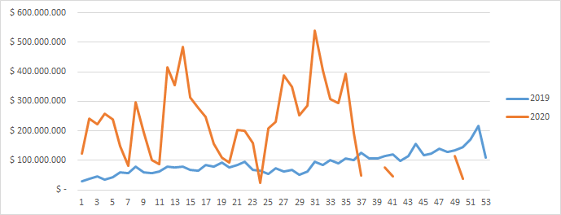
AVERAGE PRICE OF ORDERS
DS4A team 77
The time series of orders does not present a high trend compared to the time series of prices, since they are essential products, their demand may be inelastic
SALES PER-WEEK

Slide 8
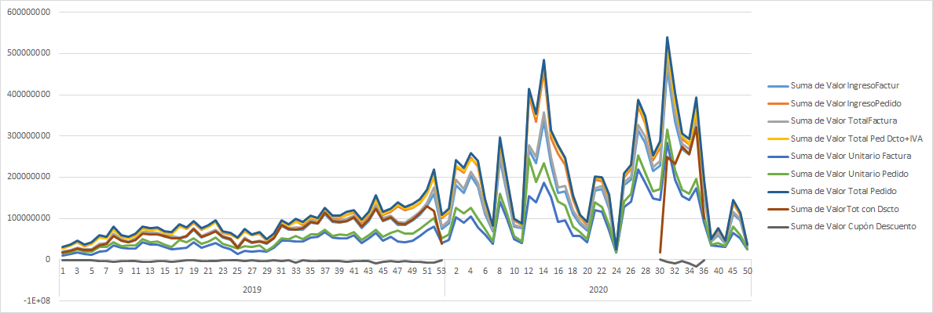
COMPARING PRICES ORDERS (TAXES, DISCOUNTS)
DS4A team 77

Slide 9
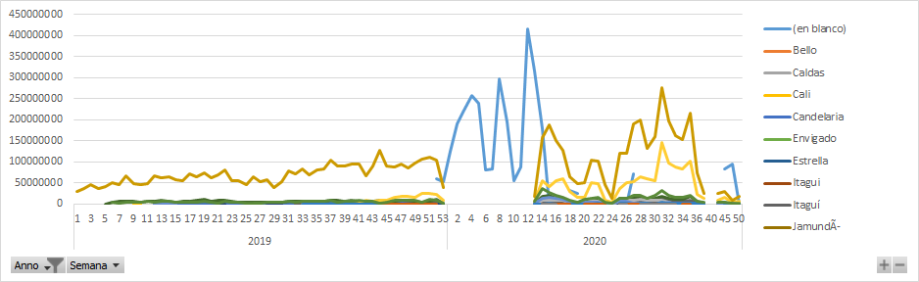
SALES PER WEEK AND CITY
DS4A team 77
The time series show that cities located in Valle del Cauca are the main market of Teaté

Slide 10
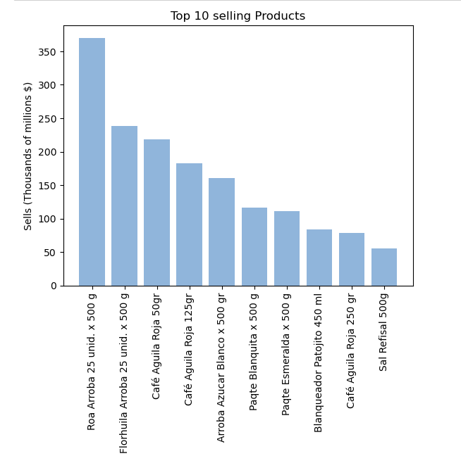
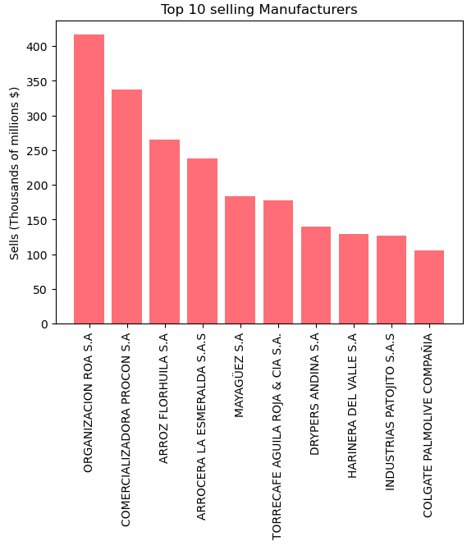
TOP 10 PRODUCTS AND MANUFACTURES
DS4A team 77
The inventory and orders are moved by food and basic products like coffee, baked products and bleach

Slide 11
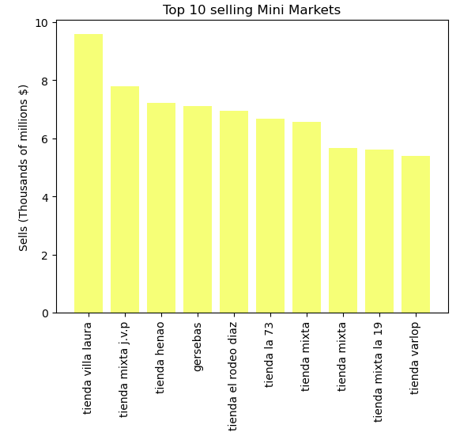
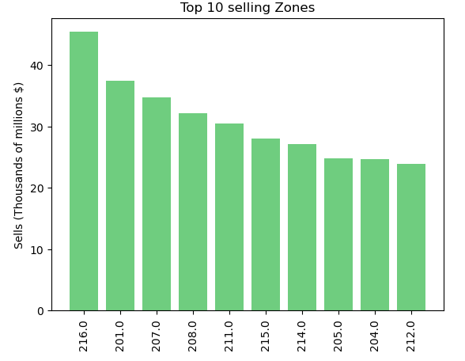
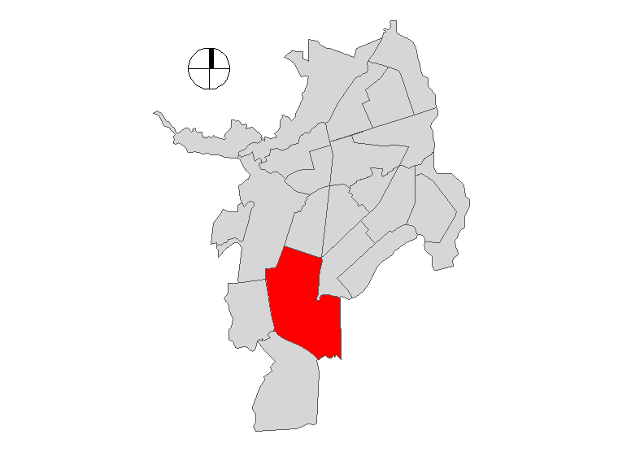
TOP 10 BUSINESS PARTNERS
DS4A team 77
The inventory and orders are moved by food and basic products like coffee, baked products and bleach
A large proportion of orders is in 17th commune

Slide 12
Next Steps
DS4A team 77
Build geofences(Polygons) for the main zones so that we can aggregate a forecast under city level.
Add geocoding data so that we can generate heatmaps and apply k mean to cluster forecast groups.
Identify geozones by tiers (High, Medium and low) based on the frequency of deliveries per week for each geozone.
For example “High” represents a geo with a high amount of deliveries per week.
Implement a hierarchy of product lines
For example, to forecast “beers” instead of just “Corona” or “Club Colombia”
We will also add a column for the Day of the month (1 to 31) and the number of the week(1 to 4) .
We will also add a column that identifies clients/vendors by tiers (1 ,2,3) based on the frequency by which each one makes orders.
Tier 1 are the 33% most frequent clients while tier 3 are the 30% least frequent..

Slide 13
Thank you
DS4A team 77

Slide 14
INDEX
1. Your project
what's the problem you should solve and why it is important 1-2mins).
2. The data
what kind of data do you have, where does it come from 1-2mins).
3. Your work and findings so far about the Data Exploratory Analysis.

Slide 15
The problem
Teaté
Connecting suppliers of goods and services with micro-merchants
deals with multiple convenience stores around the country
the demand for each product changes over time and across locations in the city
no knowledge about the amount demanded for each product in each location
how to allocate resources to supply the market on time?
Importance
Retail sector - impact on social and economic growth in Colombia
Growth rate is drastically going down in 2020.
Opportunity for Teaté to consolidate as a strategic ally for micro-merchants in the Colombian market.

Slide 16
Understanding the data
To understand the behavior of the demand for the products offered by Teaté, below are the purchase orders per unit of measure (at, package, bag, bottle, among others) for each day of the week (graph 1) following the same logic, the purchase orders grouped by (in, package, bag, bottle, among others), from January to June 2020 (graph 2) and finally the total value of the purchase orders (in thousands) grouped by (at, package, bag, bottle, among others) (graph 3):

Slide 17
Product
Ciudad

